Slide 1

Bhagwan Mahavir College Of Computer Application
Subject : Seminar
Topic : Ai
Guided by :
Asst.Prof.Kruti Patel
Presentnted by :
Sonani Darsh.
(2102020101802)

Slide 2
Table Of Content
About My Self
About Ai
Application
Benefit of Ai
Conclusion
Reference

Slide 3
About My Self
Hello everyone, I'm Sonani Darsh Manharbhai.
Currently, I'm enrolled in the 6th semester of BCA at BMCCA.
My enrollment number is 2102020101802.
I'm delighted to participate in today's seminar.
Throughout my academic journey, I've developed a keen interest in Web Development.
Thank you for giving me this great opportunity for study in BMCCA for BCA.

Slide 4
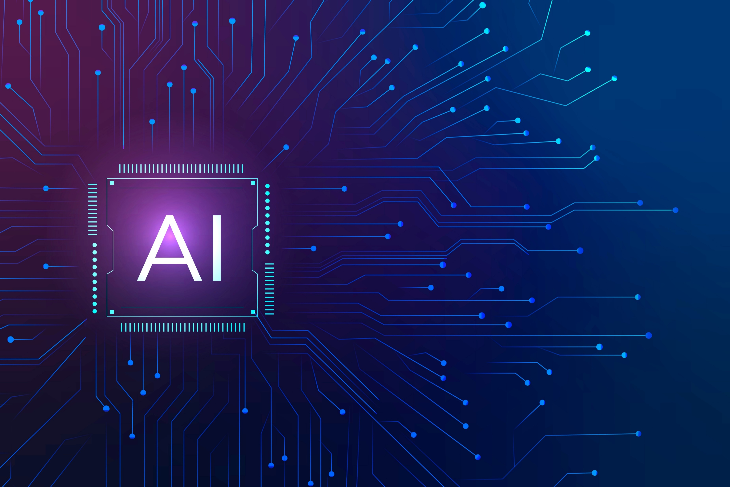
The future belongs to artificial intelligence - Mark Cuban

Slide 5
About Ai
Artificial intelligence is reshaping industries and revolutionizing the way we work.
AI promises to enhance efficiency, productivity, and decision-making across various sectors.
The potential of AI to drive innovation and solve complex problems is limitless.

Slide 6
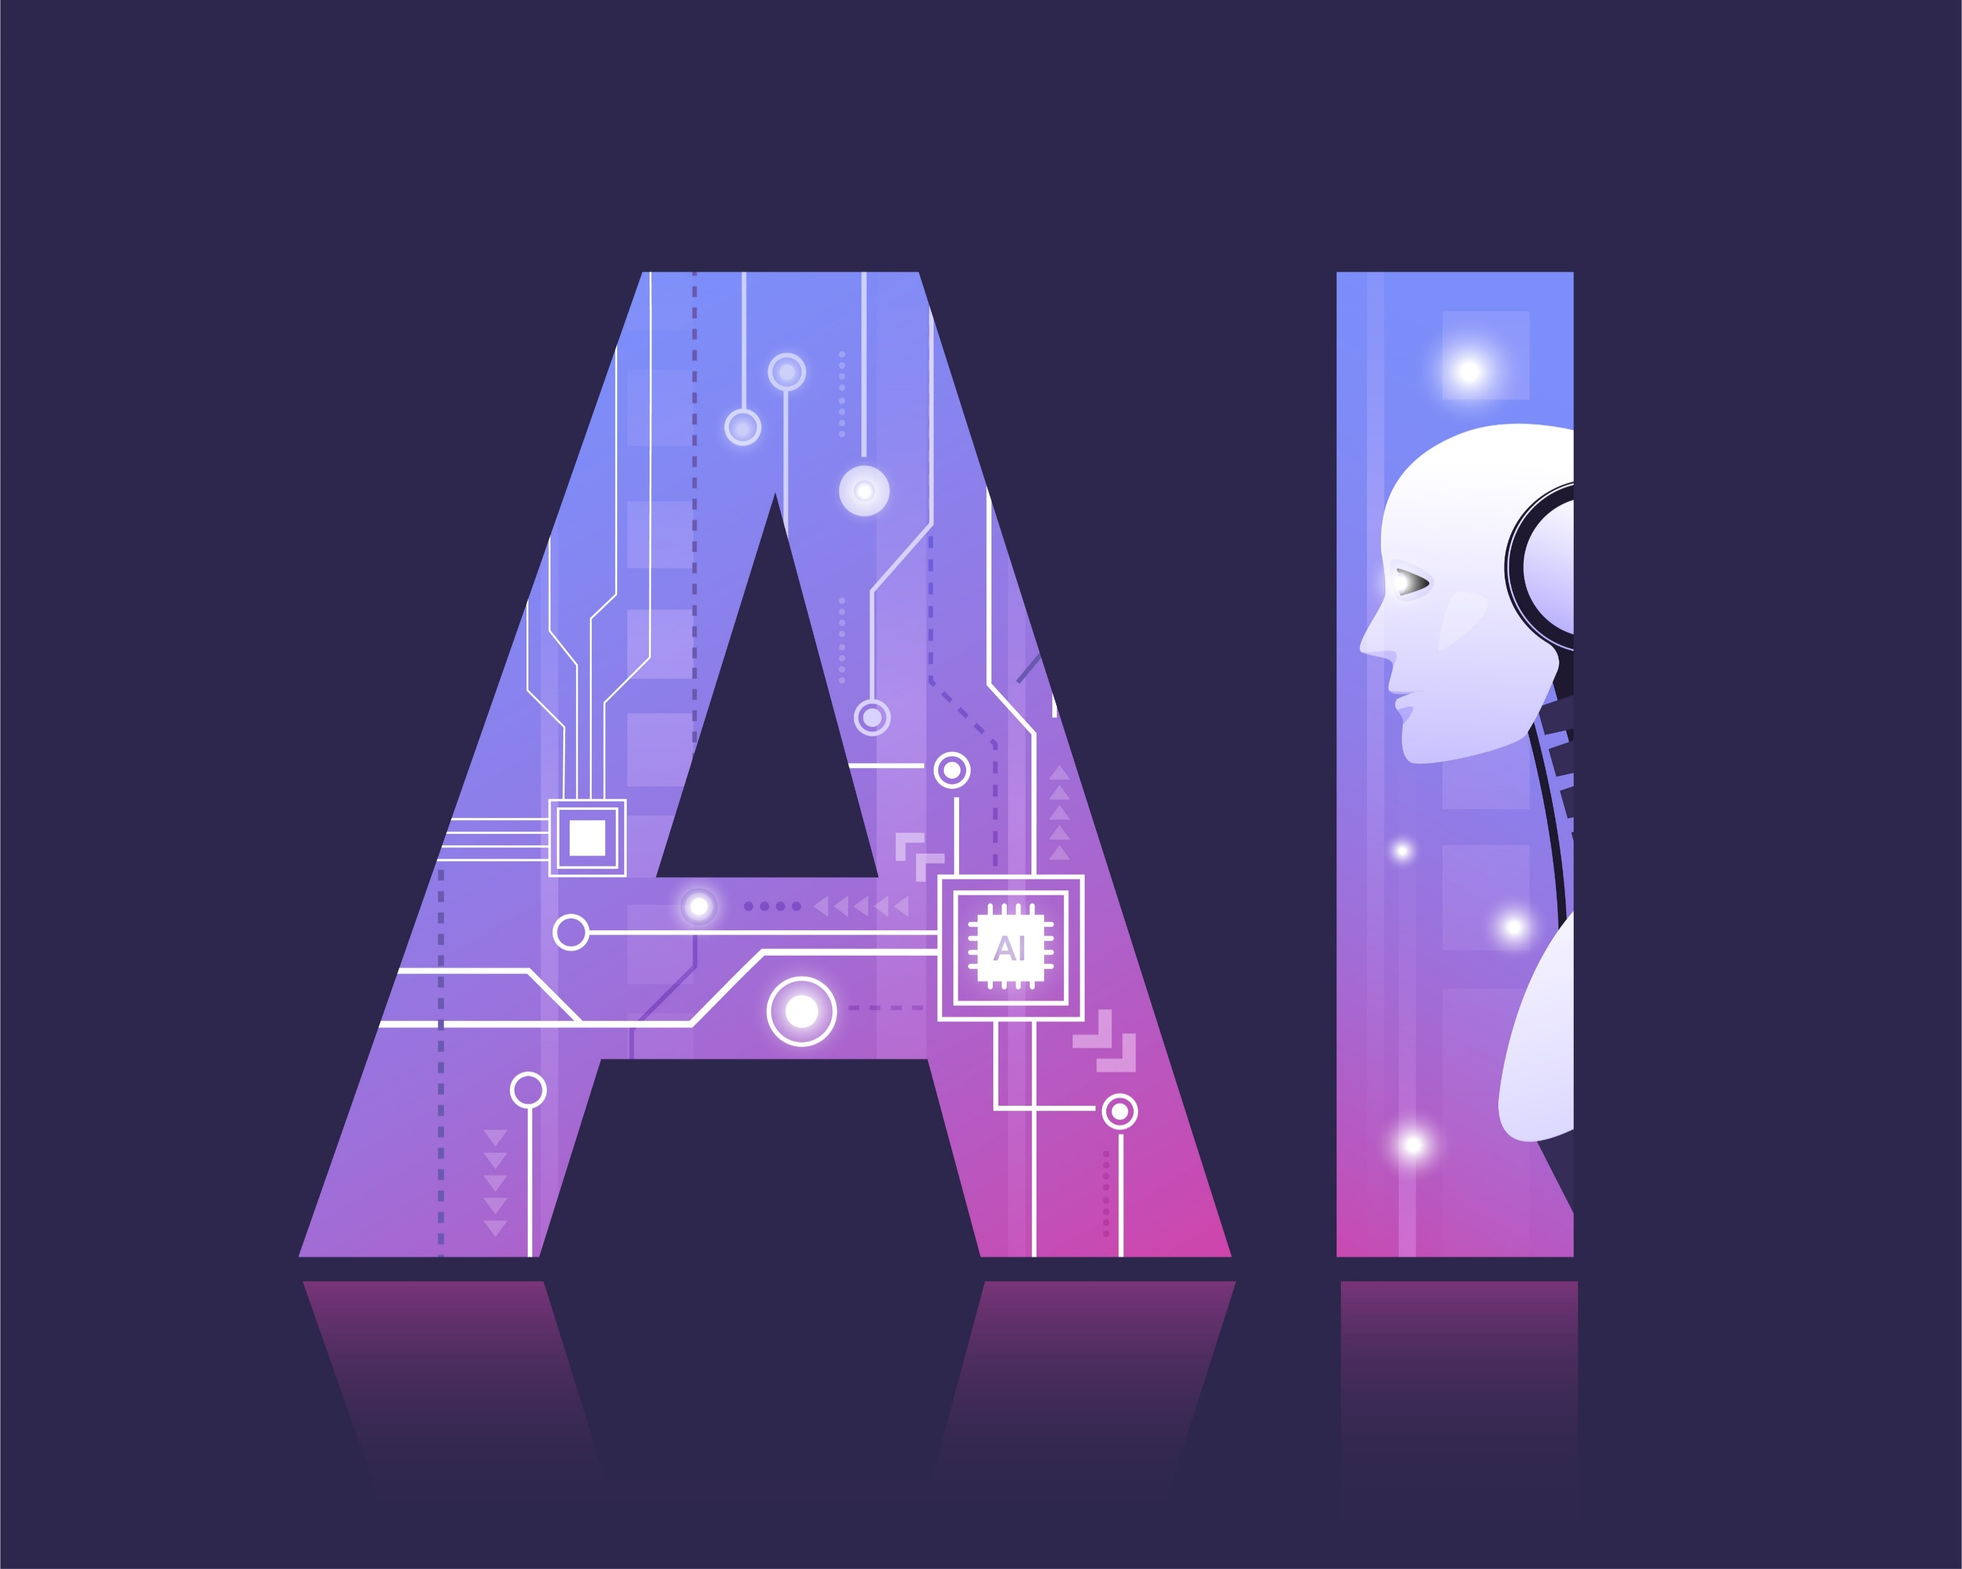
Definition
Artificial Intelligence (AI) refers to the simulation of human intelligence in machines that are programmed to think and learn like humans. It encompasses various subfields such as machine learning, natural language processing, computer vision, and robotics.

Slide 7
Definition
Artificial Intelligence (AI) refers to the development of computer systems that can perform tasks that typically require human intelligence. These tasks include learning from experience, reasoning to make decisions, understanding natural language, and perceiving and interpreting sensory inputs like images and sounds.
AI is built upon various techniques and methodologies, including machine learning, deep learning, natural language processing, computer vision, and robotics.

Slide 8
Definition
While AI has immense potential to improve efficiency, productivity, and decision-making in various domains, it also raises ethical, social, and economic concerns.
Issues such as algorithmic bias, job displacement due to automation, privacy concerns related to data usage, and the impact on societal norms and values require careful consideration as AI continues to advance.

Slide 9
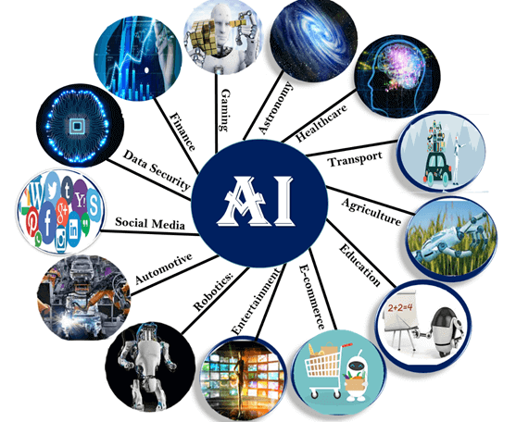
Applications Of Ai

Slide 10
Healthcare Applications
Medical Image Analysis: AI algorithms analyze medical images (MRI, CT scans, X-rays) to detect abnormalities, tumors, fractures, and other medical conditions with high accuracy.
Drug Discovery: AI accelerates drug discovery by analyzing molecular structures, simulating drug interactions, and predicting potential candidates for new medications.

Slide 11
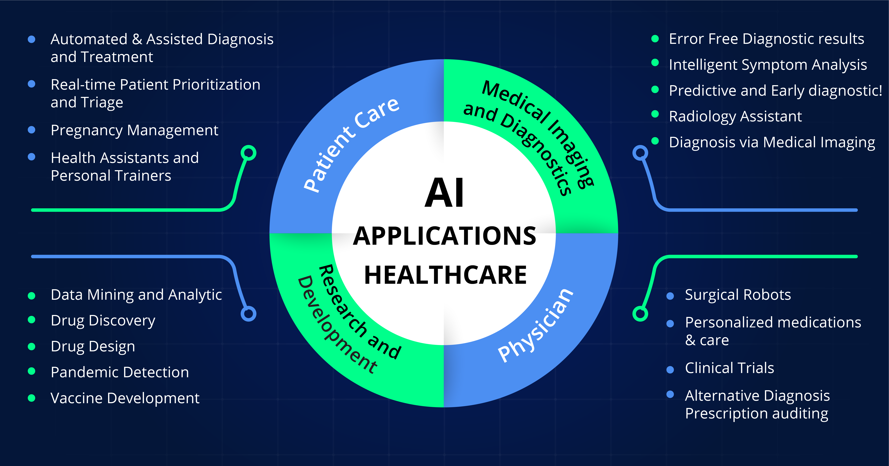
Healthcare Applications

Slide 12
Finance Applications
Algorithmic Trading: AI-powered trading systems execute high-frequency trades based on market data, news sentiment analysis, and predictive analytics to optimize investment strategies and maximize returns.
Personalized Banking: AI chatbots provide personalized financial advice, assist with account management, and offer proactive recommendations on budgeting, saving, and investing.

Slide 13
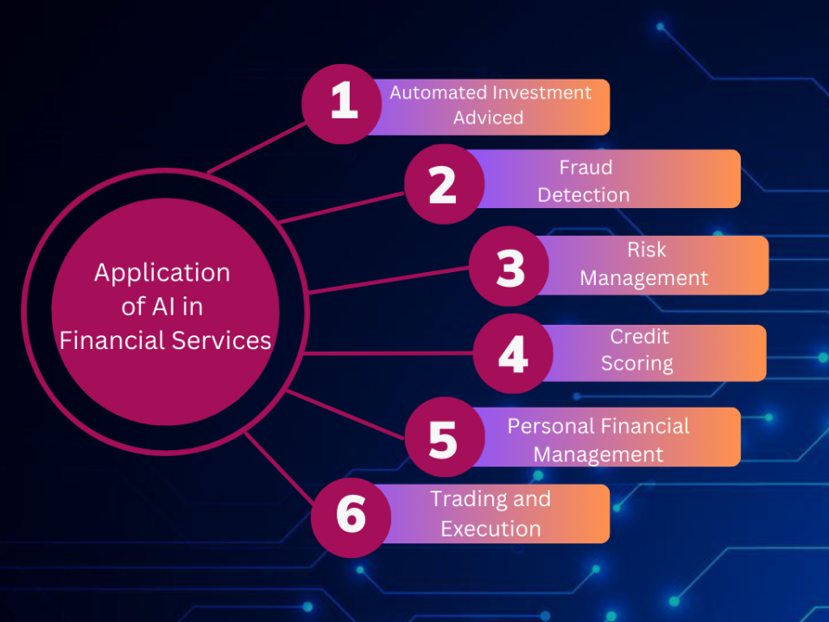
Finance Applications

Slide 14
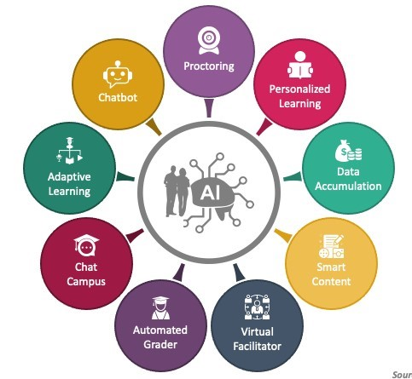
Education Applications
Adaptive Learning: AI platforms deliver personalized learning experiences by adapting course content, pacing, and assessments to students' individual needs, learning styles, and proficiency levels.
Intelligent Tutoring Systems: AI tutors provide real-time feedback, guidance, and support to students, helping them master difficult concepts, identify learning gaps, and improve academic performance.

Slide 15
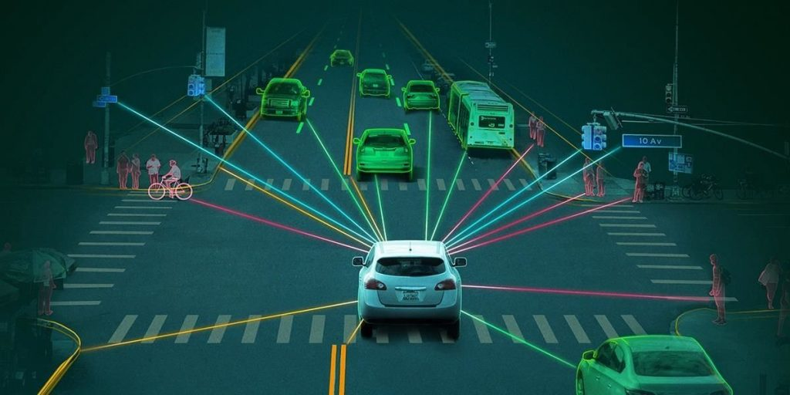
Transportation Applications
Autonomous Vehicles: AI-enabled self-driving cars use sensors, cameras, and machine learning algorithms to navigate roads, interpret traffic signals, and make real-time driving decisions to ensure passenger safety.

Slide 16
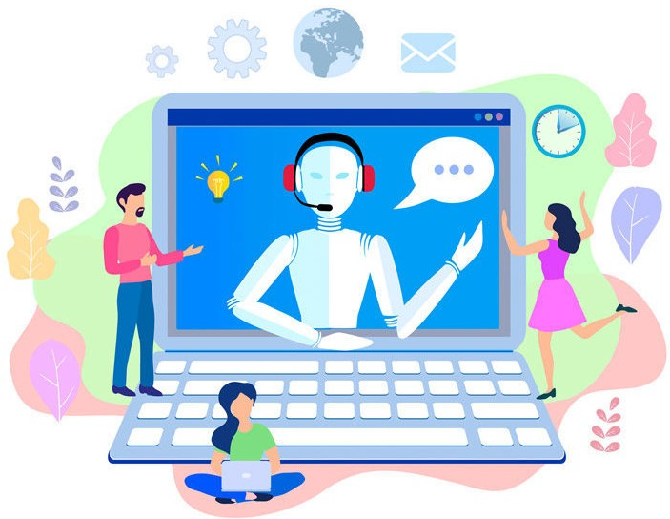
Customer Service Applications
Virtual Assistants: AI-powered chatbots and virtual agents interact with customers through natural language processing (NLP) to answer inquiries, resolve issues, and provide personalized recommendations 24/7.

Slide 17
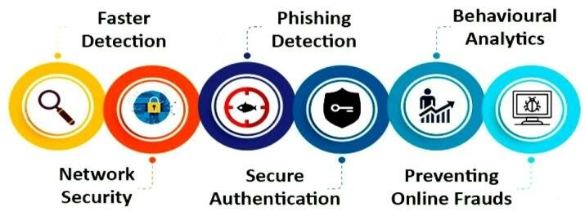
Cybersecurity Applications
Threat Detection: AI systems detect and mitigate cybersecurity threats, including malware, phishing attacks, and data breaches, by monitoring network traffic, identifying anomalies, and responding in real-time

Slide 18
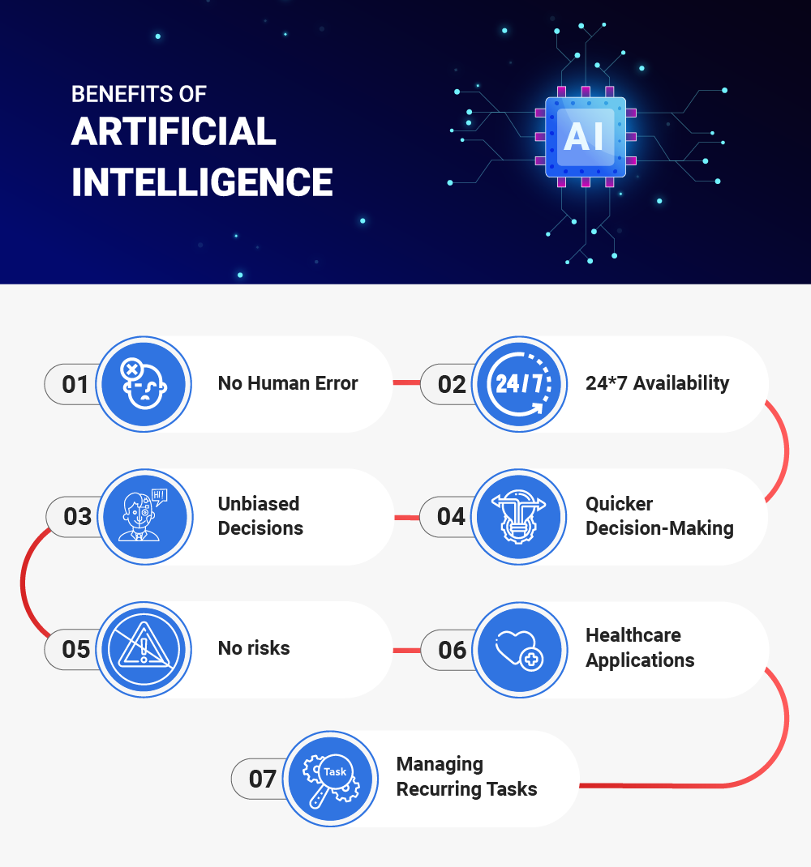
Benefits of AI

Slide 19
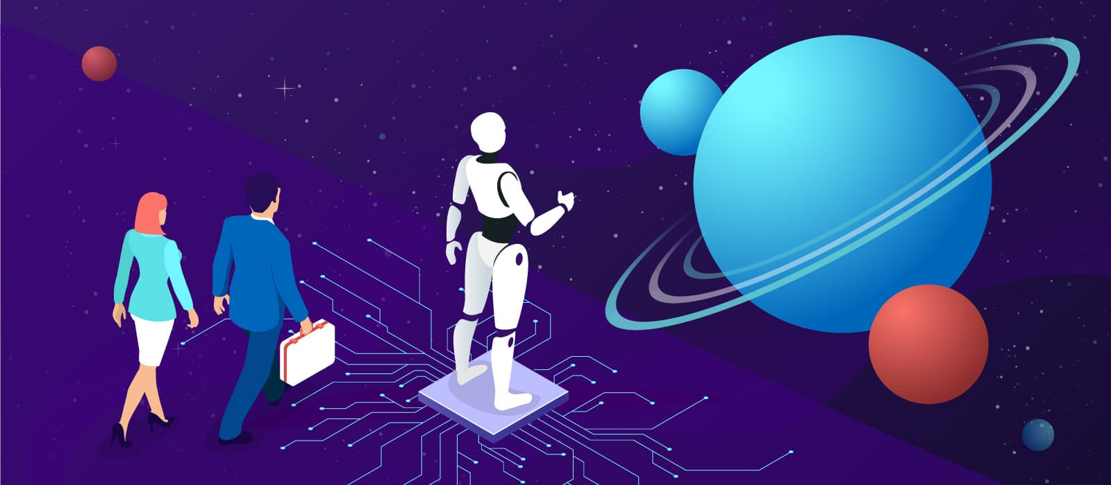
Business Efficiency
Automation of repetitive tasks leads to increased productivity.
Streamlining processes reduces the time and resources required for operations.
AI-powered analytics provide valuable insights for optimizing workflows and resource allocation.

Slide 20
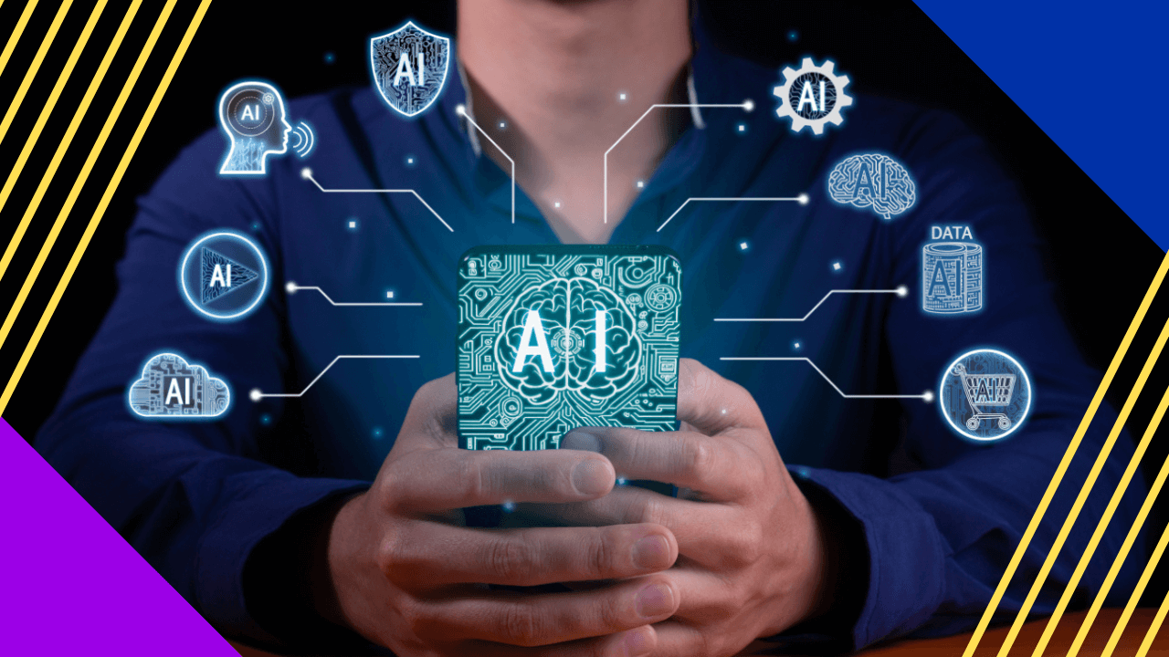
Accuracy and Precision
AI algorithms perform tasks with a high degree of accuracy, minimizing errors.
Predictive analytics and machine learning models improve accuracy in forecasting and decision-making.

Slide 21
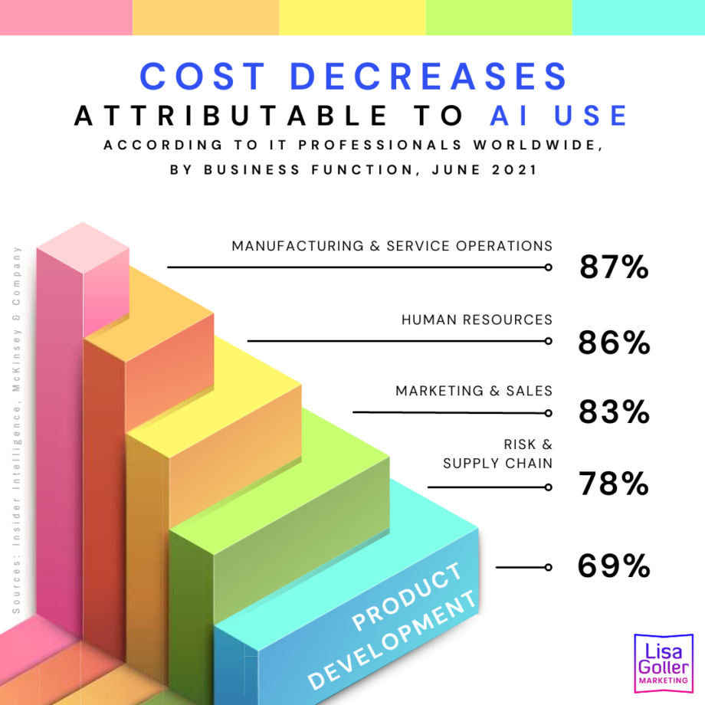
Cost Reduction
Automation reduces the need for manual labor, saving on labor costs.
Predictive maintenance helps prevent equipment breakdowns, reducing maintenance expenses.

Slide 22
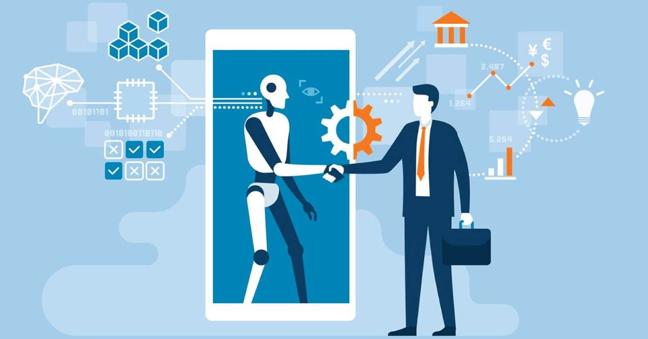
Personalization
AI enables personalized experiences for users by analyzing their preferences and behavior.
Recommendation systems in e-commerce and content platforms offer tailored suggestions to users.

Slide 23
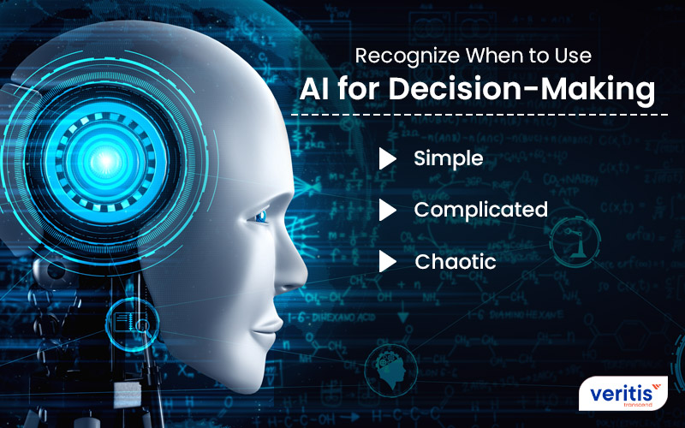
Decision Support
AI-based analytics provide actionable insights from large datasets, facilitating data-driven decision-making.
Natural Language Processing (NLP) enables sentiment analysis and trend identification from customer feedback and social media data.

Slide 24
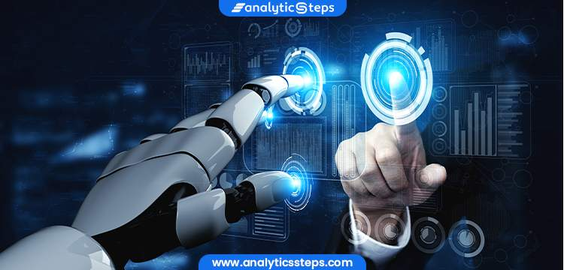
Innovation
AI fuels innovation by enabling the development of novel products and services.
Machine learning algorithms drive advancements in areas such as healthcare diagnostics, autonomous vehicles, and predictive maintenance.

Slide 25
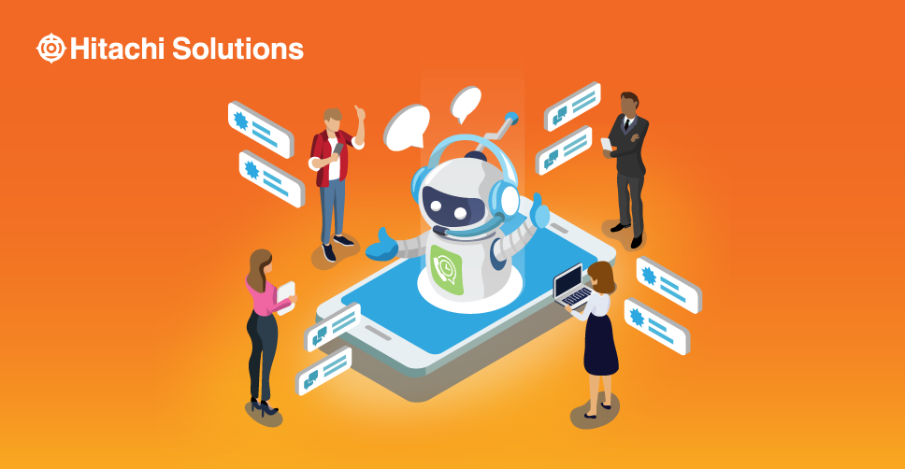
Customer Service:
Chatbots and virtual assistants provide round-the-clock customer support, improving response times and customer satisfaction.
Natural Language Understanding (NLU) allows AI systems to interpret and respond to customer queries accurately.

Slide 26
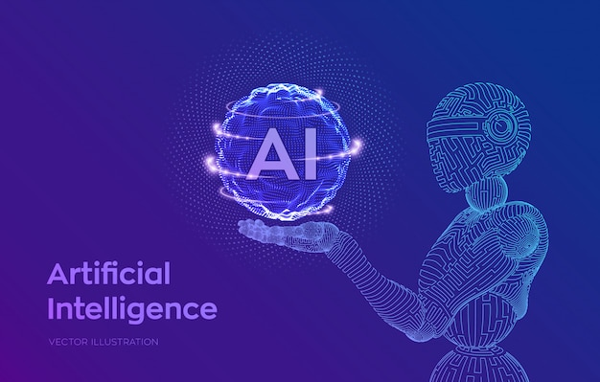
Conclusion
Ai is the feature of all sector
Ai can make everything which human can’t make.
Ai is very powerfull.
Ai will handle all the sector in feature.

Slide 27
Reference
https://en.wikipedia.org/wiki/Artificial_intelligence
https://en.wikipedia.org/wiki/Applications_of_artificial_intelligence

Slide 28
Thank You
Thank you for your time and attention.
In summary, we explored the various applications and benefits of artificial intelligence.

